Slide 1
Financial Analytics

Slide 2
Agenda
01. Introduction
02. Data Description
03. Key Performance Indicators (KPIs)
04. My Design
05. Findings and Insights
06. Recommendations

Slide 3

Introduction
Objective: Analyze competition among the top 500 companies in India.
Focus: Market Capitalization & Quarterly Sales Data
Tools Used: Tableau for data visualization
Goals:
Identify key competitors and market leaders.
Explore trends and patterns in the data.
Provide insights for strategic decision-making.

Slide 4
Dataset Description
Source: The dataset contains financial information for the top 50 companies in India.
Number of Records: 488 entries
Fields:
Serial Number (S.No.): Unique identifier for each record
Name: Name of the company
Mar Cap - Crore: Market Capitalization in Crores
Sales Qtr - Crore: Quarterly Sales in Crores

Slide 5
Key Performance Indicators (KPIs)
Market Capitalization: The total market value of a company's outstanding shares, indicating its size and market value.
Quarterly Sales: The total revenue generated by a company in a quarter, crucial for assessing financial performance and growth potential.

Slide 6

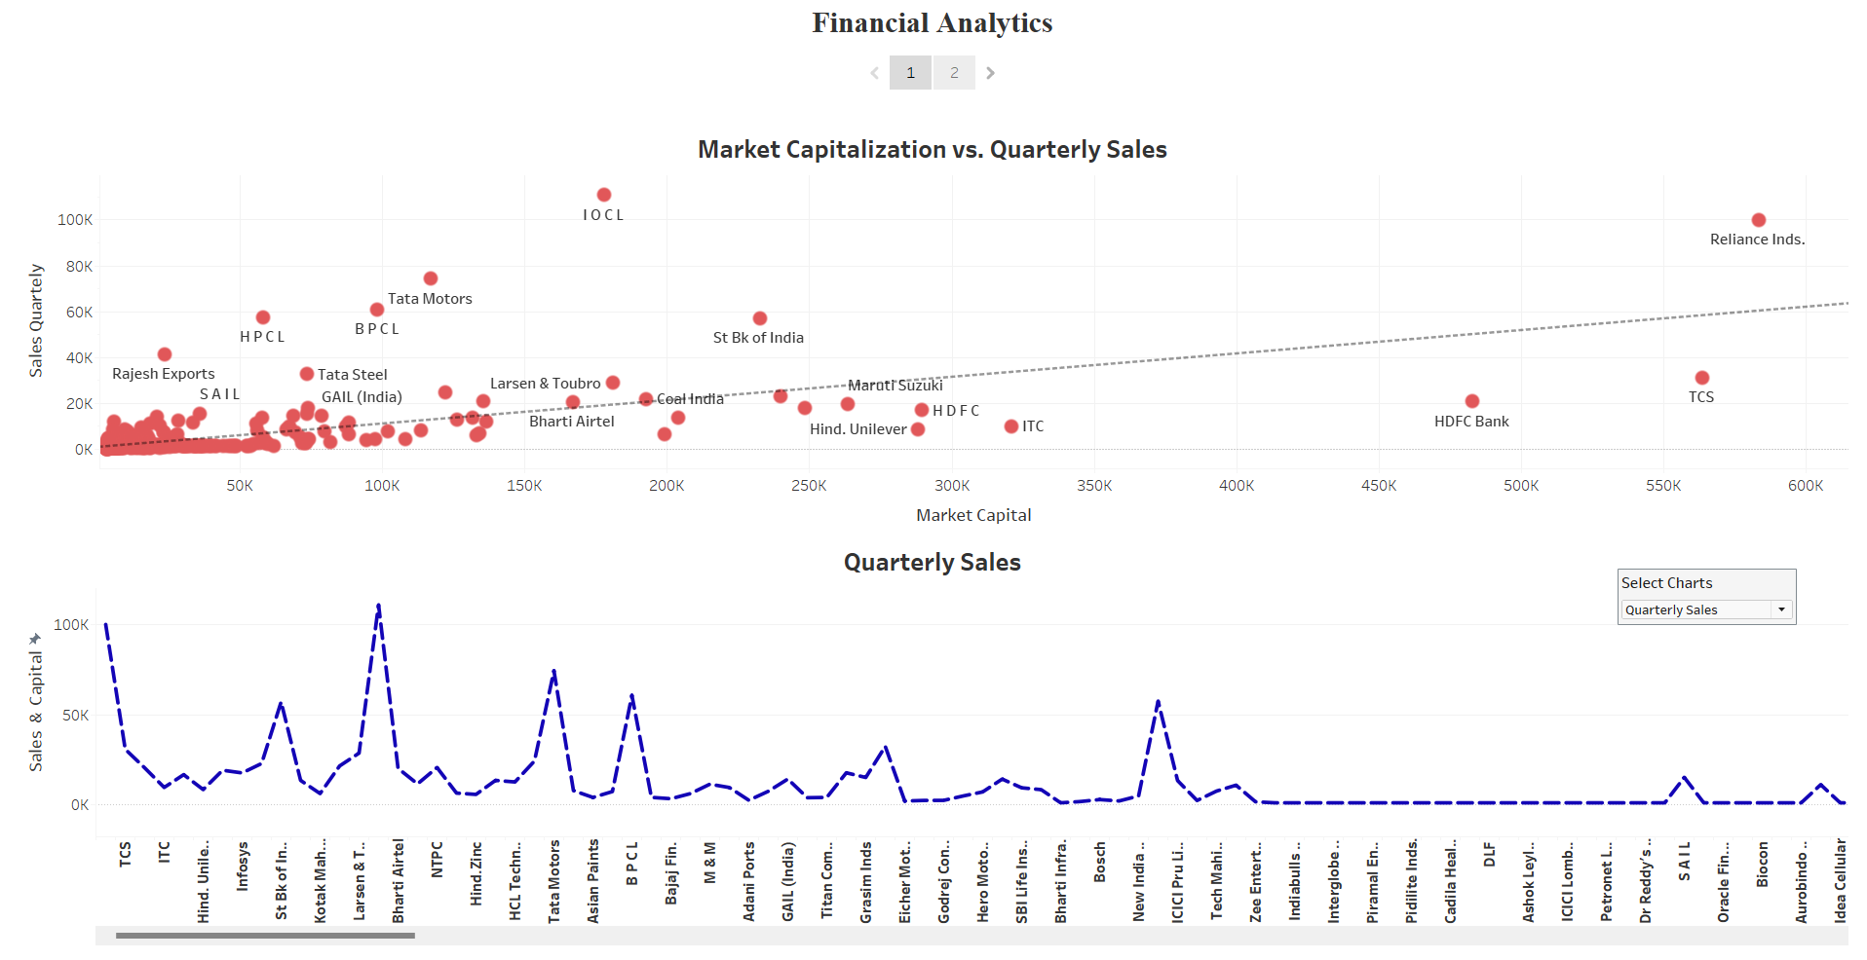
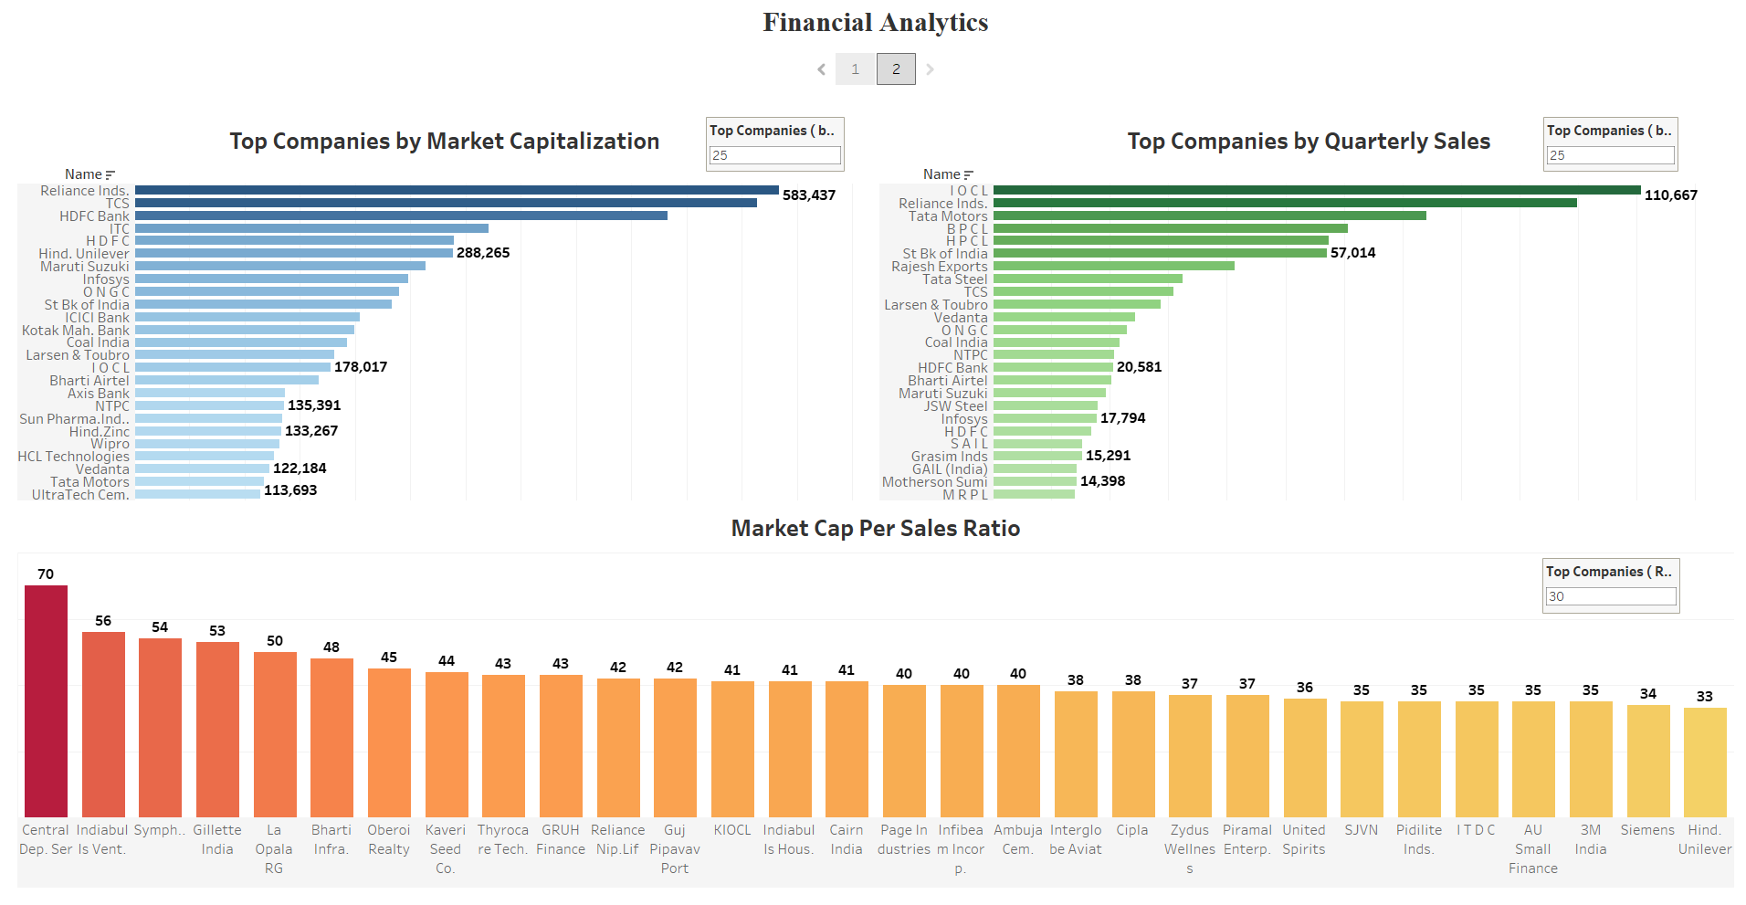
My Design
Project Financial Analytics | Tableau Public

Slide 7
Findings and Insights
Top Companies by Market Cap
Reliance Industries and TCS lead in market capitalization.
Top Companies by Quarterly Sales
IOC and Reliance Industries have the highest quarterly sales.
Market Cap Per Sales Ratio
Indiabulls Venture and Gillette India have high ratios, indicating strong valuation relative to sales.
Market Cap vs Quarterly Sales
Positive correlation observed; Reliance, TCS, and HDFC Bank are notable leaders.
Quarterly Sales Trends
Seasonal sales spikes seen in Reliance Industries and IOCL.

Slide 8
Recommendations
Strategic Investments: Focus on sectors with high growth potential.
Competitive Analysis: Regularly monitor competitors and market trends.
Sales Optimization: Companies with low sales relative to market cap should explore new markets or products.
Further Analysis: Consider deeper dives into profitability and market trends for strategic insights.

Slide 9

Thank you
The analysis reveals market leaders and key growth areas among the top 500 companies in India.

